Slide 1
Targeted Neighborhood Revitalization
Using the Choice Neighborhood Initiative
Whittier/Nubian Square

Slide 2
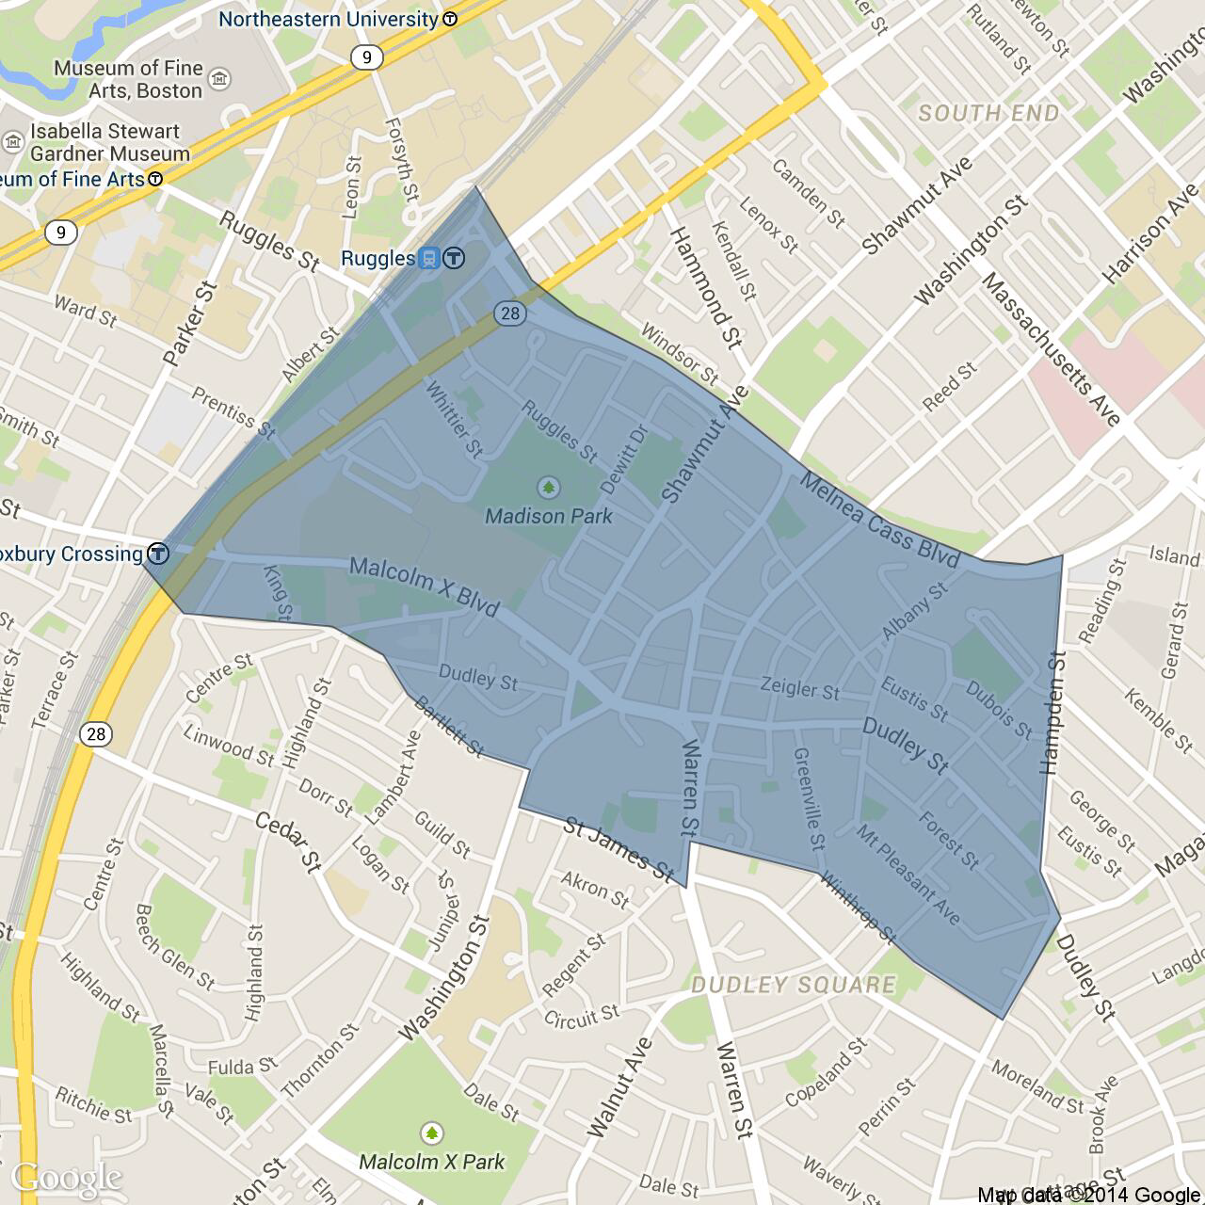
WHITTIER CHOICE NEIGHBORHOODS INITIATIVE
The Boston Housing Authority (BHA) & the City of Boston’s Department of Neighborhood Development (DND) jointly applied for & were awarded Choice Neighborhoods Initiative (CNI) funding in 2016 for the Whittier/Nubian Square neighborhood.
CNI focuses on the revitalization/ redevelopment of public or multifamily housing, while also identifying the broader community needs for services and neighborhood improvements.
WHittier Target

Slide 3
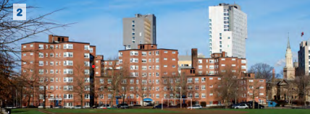
BACKGROUND: WHITTIER TRANSFORMATION PLAN
In 2012, the BHA received a CNI planning grant to help them re-imagine the Whittier Housing Development and the surrounding neighborhoods.
The BHA procured Madison Park Development Corporation (MPDC) and Preservation of Affordable Housing (POAH) to be its development partners and help implement a transformation plan.
The partners worked with tenants, neighbors and stakeholders to formulate a transformation plan.
HUD awarded a $30M CNI implementation grant in 2016.

Slide 4
3 REVITALIZATION STRATEGY COMPONENTS
The Transformation Plan has three components:
Housing Transformation: Reimagine Whittier Housing Development as a mixed income development and identify new housing opportunities for Whittier residents beyond Whittier.
Services for the People: Address the needs of Whittier residents through enhanced services provided through Empath and other providers, including their partner MPDC.
Critical Community Improvements: Make improvements to and create new opportunities within the broader neighborhood infrastructure, public spaces, residential and commercial areas that will make a positive impact Whittier residents.

Slide 5
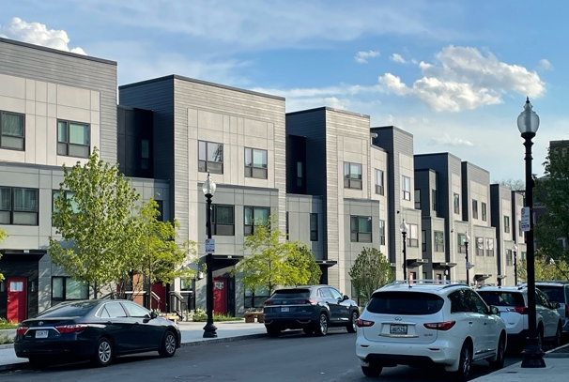
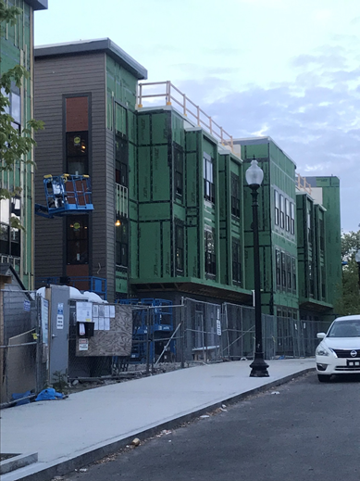
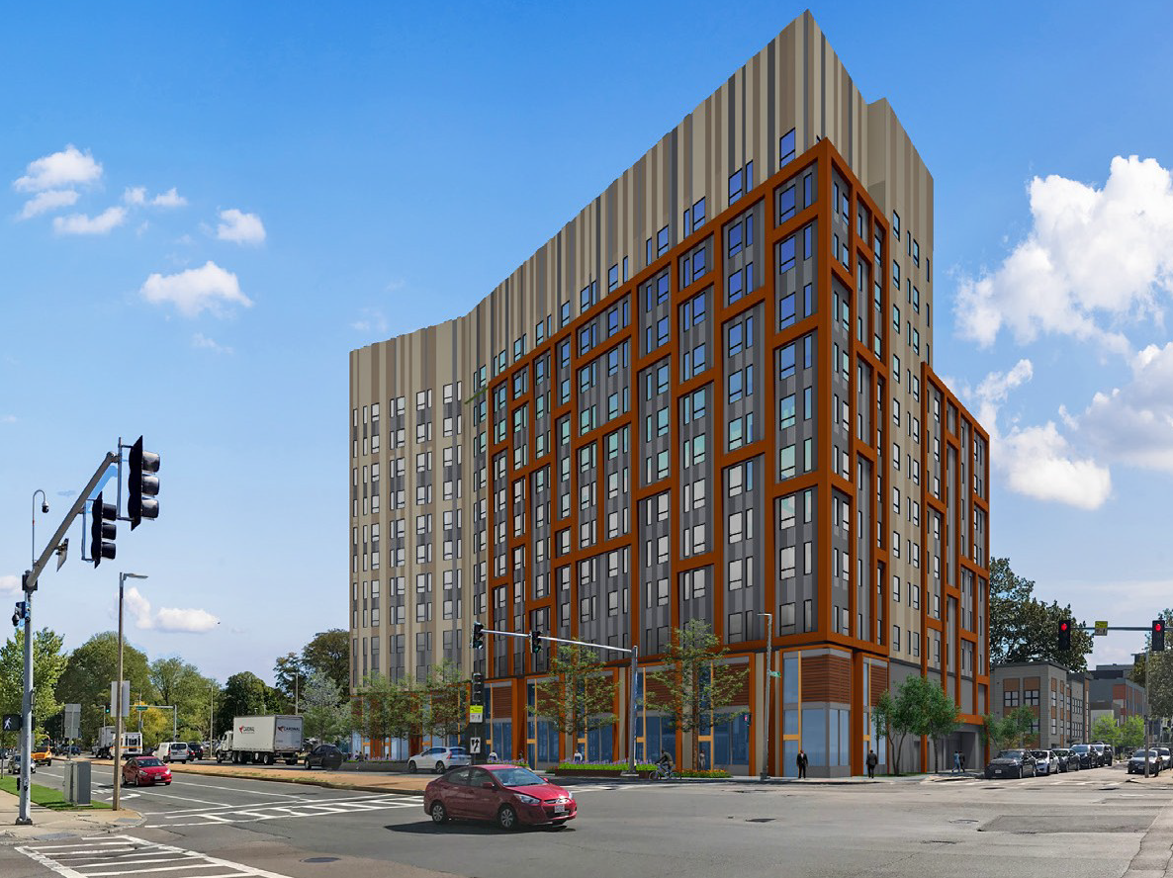
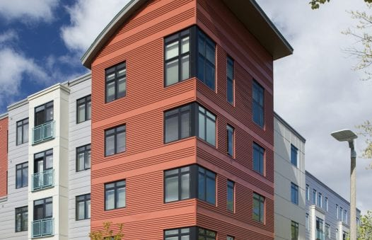
WHITTIER HOUSING TRANSFORMATION
Whittier is being transformed from 210 public housing units to 316 mixed income units. CNI also helped fund the adjacent 76 unit Melnea Cass Apartments (MCA).
All the original units will be replaced--154 at Whittier & MCA, and 56 in other local housing developments.
Whittier Phase 1 (above) is completed and Phase 2 (left) is under construction. Phase 3 (far left)is expected to break ground early next year. MCA (below) is complete.

Slide 6
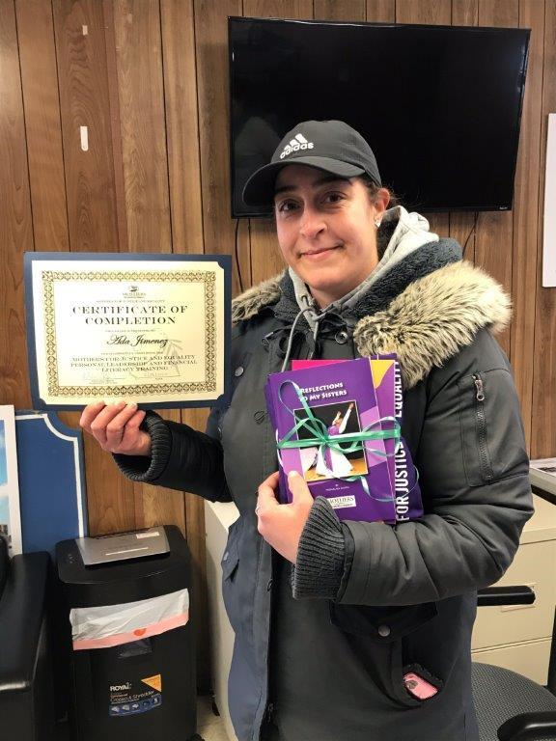
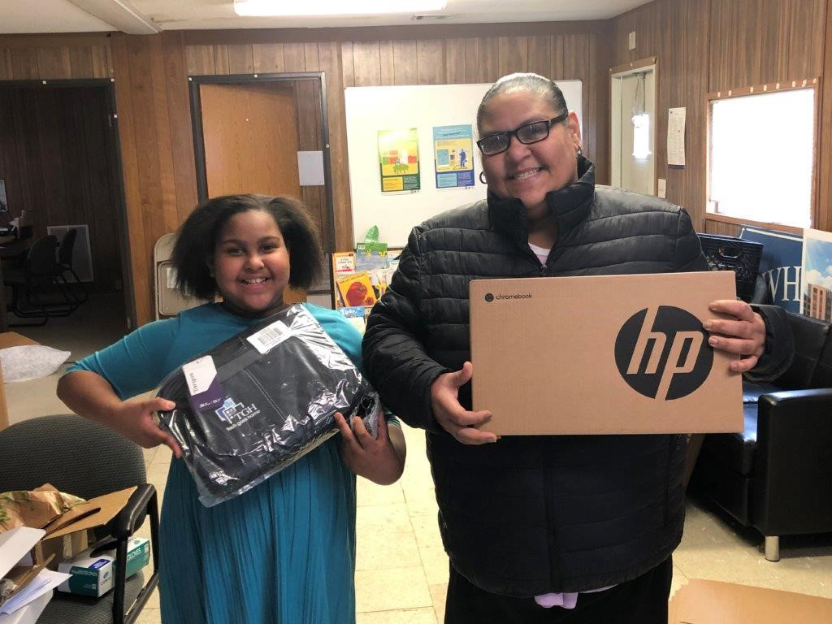
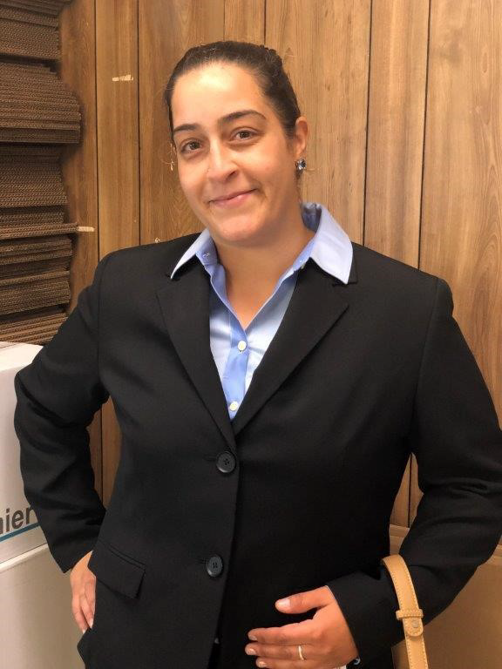
WHITTIER “PEOPLE” SERVICES
The BHA procured Economic Mobility Pathways (EMPath) as its CNI “People” services provider. The organization is focused on helping low-income people reach economic independence, using a holistic approach that encompasses health, family life, career, finances and education. Their staff helps residents with job readiness and childcare search, advancing in education, learning about home finances, and navigating the school system.

Slide 7
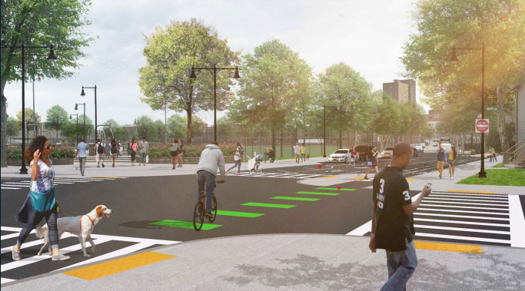
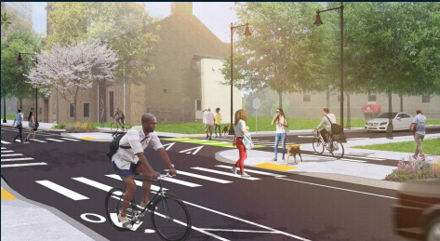
WHITTIER CRITICAL COMMUNITY IMPROVEMENTS
Neighborhood improvements are an important piece of the CNI plan & budget. Nubian Square, the commercial district within the Whittier target area, is ripe for revitalization. Improvements include:
Ruggles Street, which borders the Whittier development, is being redesigned to be more pedestrian and bike friendly
Wicked Free WiFi will be available for area residents
Police cameras will be placed on new streetlights
Art installation and street amenities will be installed

Slide 8
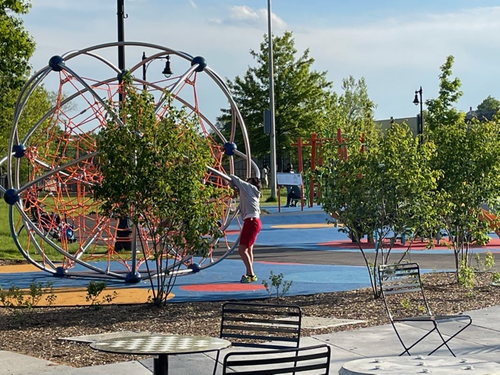
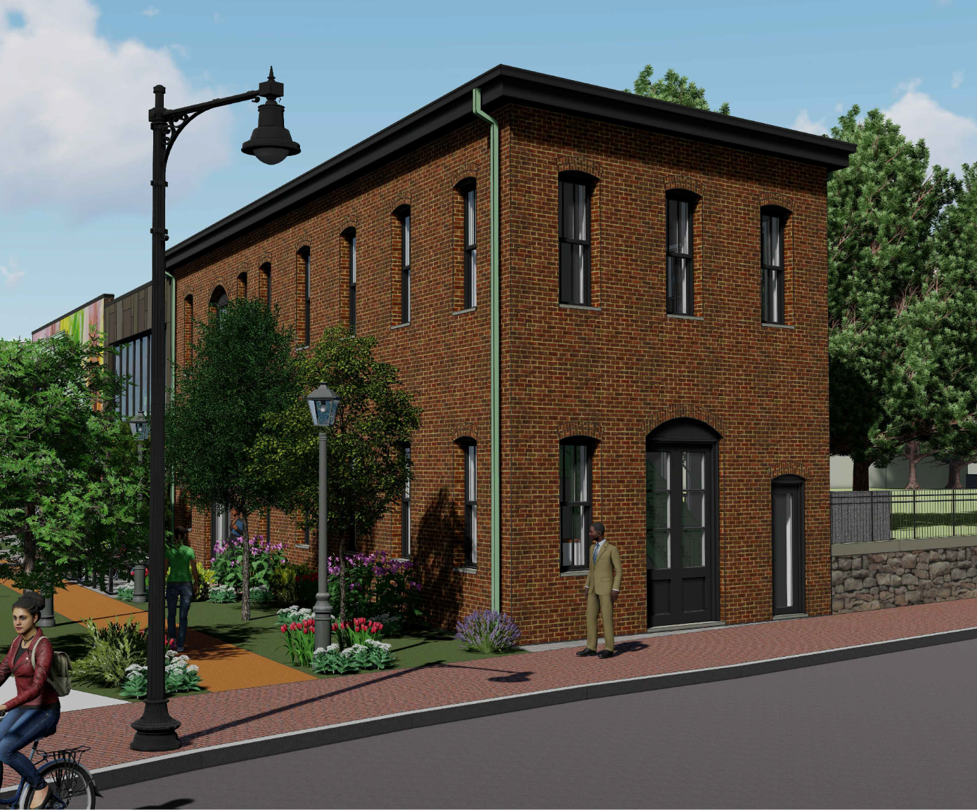
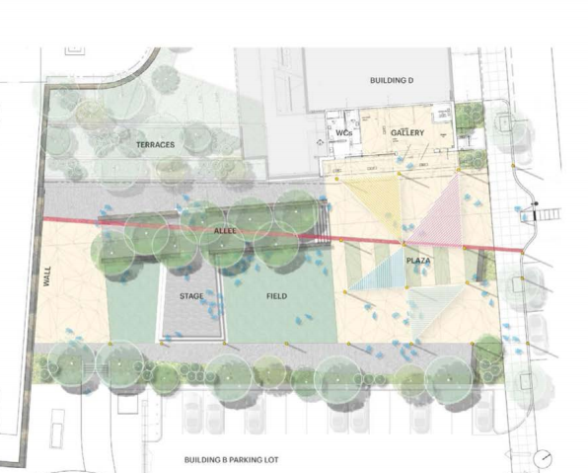
WHITTIER CRITICAL COMMUNITY IMPROVEMENTS
Park and open space improvements at two locations--Dewitt Park and on the opposite end of Nubian Square at Bartlett Station.
Historic restoration and reuse of the nineteenth-century Nawn Factory property, located in the Roxbury historic district.
Dewitt Park
Nawn Factory
Oasis at Bartlett Station

Slide 9
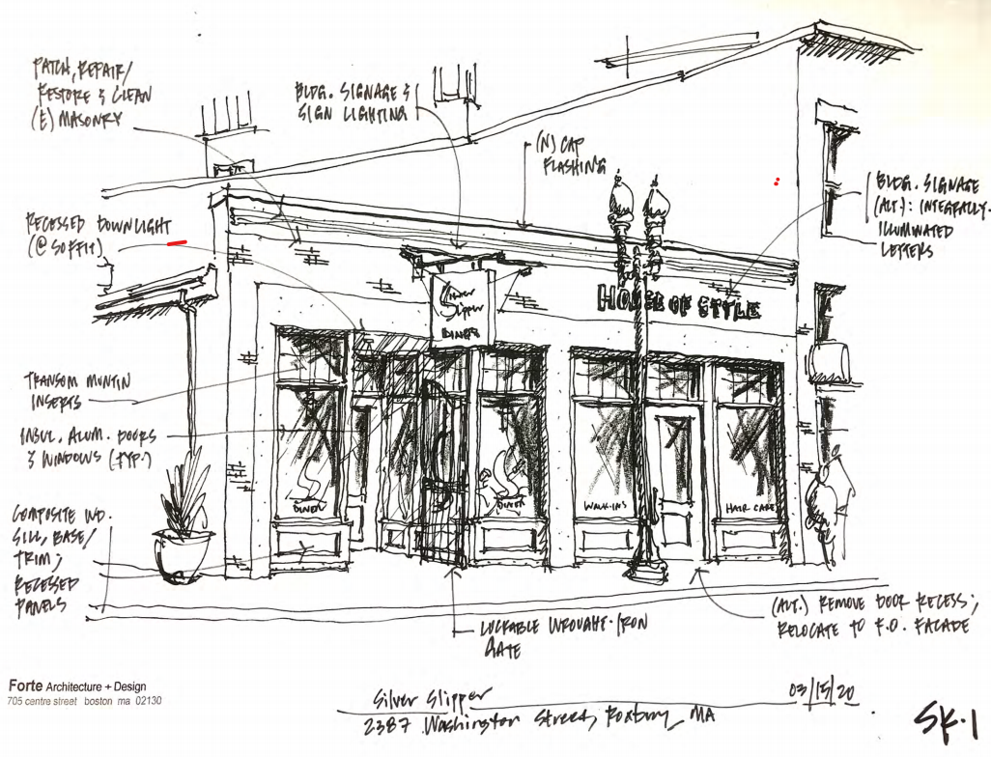
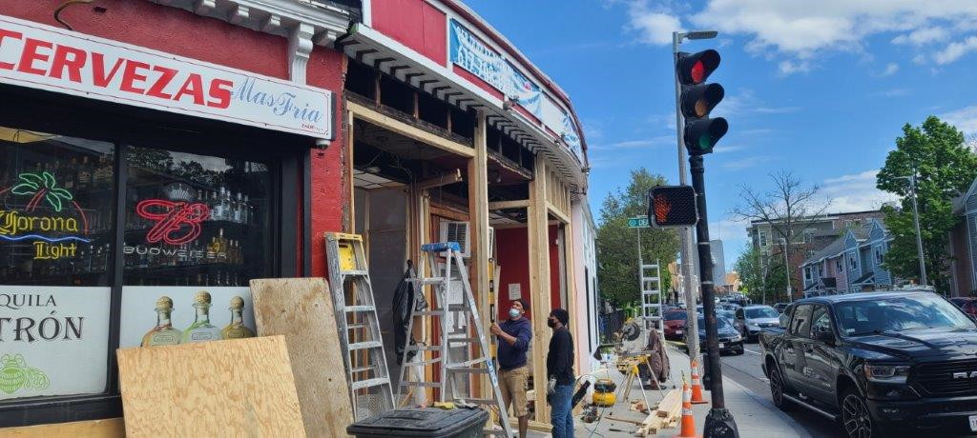
WHITTIER CRITICAL COMMUNITY IMPROVEMENTS
Other planned improvement projects include:
The City’s facade improvement program, RESTORE, is being enhanced, increasing the amount of funding available for projects in Nubian Sq.
Acquisition Assistance Program which will assist local business owners to purchase commercial property in Nubian Square.
Enhanced Homebuyer assistance to Whittier area residents, with a priority for Whittier Housing Development tenants.

Slide 10
PUBLIC CAPITAL INVESTMENTS IN THE WHITTIER PLAN
 | Total Cost* | CNI Funds | City Funds | State Funds
Housing
Whittier Ph 1-3 | $179,111,000 | $17,961,000 | $7,050,000 | $5,950,000
Melnea Cass Apts | $ 39,025,000 | $ 1,000,000 | $2,650,000 | $3,000,000
Comm. Improvements
Parks/Open Space | $ 3,603,000 | $ 1,800,000 | $ 580,000 | $1,223,000
Ruggles Street/Art | $ 7,180,000 | $ 780,000 | $6,400,000
Nawn Factory | $ 5,200,000 | $ 500,000 | $ 250,000 | $ 800,000
Commercial Programs | $ 1,870,000 | $ 1,420,000 | $ 200,000
Homeownership Asst | $ 700,000 |  | $ 700,000
*Totals include all sources, including private equity and other resources

Slide 11
QUESTIONS

